Slide 1
Subject : Software Engineering and Project Management
Topic : Unified Modeling Language (UML)
Prepared By
Prof. Mohd Tahir
Anjuman College Of Engg. & Tech.
Department Of Computer Science & Engg.

Slide 2
Syllabus (Software Engineering and Project Management– 6th Sem CSE
Introduction: Software Characteristics, Software Engineering‐ A Layered Technology, Software Process Framework, Software Process Models, Waterfall Model, Incremental Process Models, Evolutionary Process Models, Specialized Process Models, The Unified Process Model, Agile Process Models.
Software engineering Principles and Practice :Communication Practices, Planning Practices, Modeling Practices, Construction Practice & Deployment, System Engineering Hierarchy, Business Process Engineering, Product Engineering, System Modeling, Requirements Engineering.
System Analysis: Structured Analysis, Data modeling, Object‐Oriented Analysis, Scenario‐Based Modeling, Flow‐Oriented Modeling, Class‐based Modeling, Behavioral Model, Design Concepts : Abstraction , Pattern modularity, Information hiding, Design classes, Refactoring.
Software Testing: Testing Fundamentals, Black‐Box Testing, White‐Box Testing, Unit Testing, Integration Testing, Validation Testing, System Testing, Debugging.
Quality Management: Product Metrics, Metrics for Analysis & Design Models, Metrics for Source Code, Metrics for Testing & Maintenance. Quality concepts, Evolution of Quality Management, Quality assurance, Software reviews, Statistical quality assurance.
Project management : Introduction to Software Project Management, Project Planning, Project scheduling, Risk management , Change Management, Software reengineering, Restructuring Reverse engineering, Forward Engineering.

Slide 3
Course Outcome
Apply the process to be followed in the software development life-cycle models.
Implement communication, modeling, construction & deployment practices in software development.
Analyze & design the software models using unified modeling language (UML).
Explain the concepts of various software testing methods & be able to apply appropriate testing approaches for development of software.
Understand the quality management & different types of metrics used in software development.
Apply the concepts of project management & planning.

Slide 4
Contents:-
Activity Diagram
Use Case Diagram
Class Diagram
Object Diagram

Slide 5
Activity Diagram
Activity diagram is also another important diagram in UML to describe the dynamic aspects of the system.
Activity diagram is basically a flow-chart to represent the flow from one activity to another activity. The activity can be described as an operation of the system.
The control flow is drawn from one operation to another operation. This flow can be sequential, or branched, or concurrent. Activity diagrams deal with all type of flow control by using different elements such as (fork, join, etc)

Slide 6
Purpose of Activity Diagrams
The basic purposes of activity diagrams is similar to other diagrams. It captures the dynamic behavior of the system. Other diagrams are used to show the message flow from one object to another but activity diagram is used to show message flow from one activity to another.
Activity is a particular operation of the system. Activity diagrams are not only used for visualizing the dynamic nature of a system, but they are also used to construct the executable system by using forward and reverse engineering techniques. The only missing thing in the activity diagram is the message part.
It does not show any message flow from one activity to another. Activity diagram is sometimes considered as the flow-chart. Although the diagrams of activity diagram look like a flowchart, they are not. It shows different flows such as parallel, branched, concurrent, and single.
The purpose of an activity diagram can be described as −
Draw the activity flow of a system.
Describe the sequence from one activity to another.
Describe the parallel, branched and concurrent flow of the system.

Slide 7
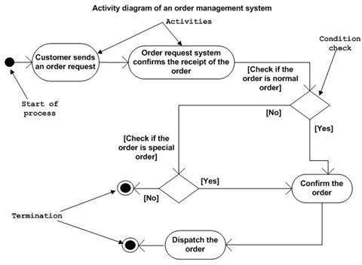

Slide 8
Use Case Diagram
Use case diagrams are a set of use cases, actors, and their relationships. They represent the use case view of a system.
A use case represents a particular functionality of a system. Hence, use case diagram is used to describe the relationships among the functionalities and their internal/external controllers. These controllers are known as actors.
The purposes of use case diagrams can be said to be as follows −
Used to gather the requirements of a system.
Used to get an outside view of a system.
Identify the external and internal factors influencing the system.
Show the interaction among the requirements are actors.

Slide 9
Use case diagram symbols and notation
The notation for a use case diagram is straight forward and doesn't involve as many types of symbols as other UML diagrams. Here are all the shapes you will be able to find in Lucid chart:
Use cases: Horizontally ovals shaped that represent the different uses that a user might have.
Actors: Stick figures that represent the people. actually employing the use cases.
Associations: A line between actors and use-cases. In complex diagrams, it is important to know which actors are associated with which use cases.
System boundary boxes: A box that sets a system scope to use cases. All use cases outside the box would be considered outside the scope of that system.
Packages: A UML shape that allows you to put different elements into groups. Just as with component diagrams, these groupings are represented as file folders.

Slide 10
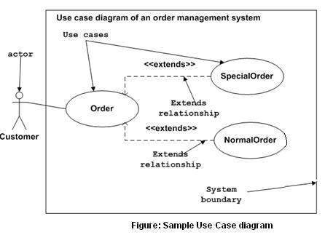

Slide 11
Class Diagram
Class diagrams are the most common diagrams used in UML .
Class is the type or structure that can be used number of times by declaring object.
Class diagram consists of classes, associations , interfaces, and collaboration. Class diagrams basically represent the object-oriented of system, which is static in nature.
Active class is used in a class diagram to represent the concurrency of the system.
Class diagram represents the object orientation of a system. Hence, it is generally used for development. This is mostly used at the time of system construction.

Slide 12
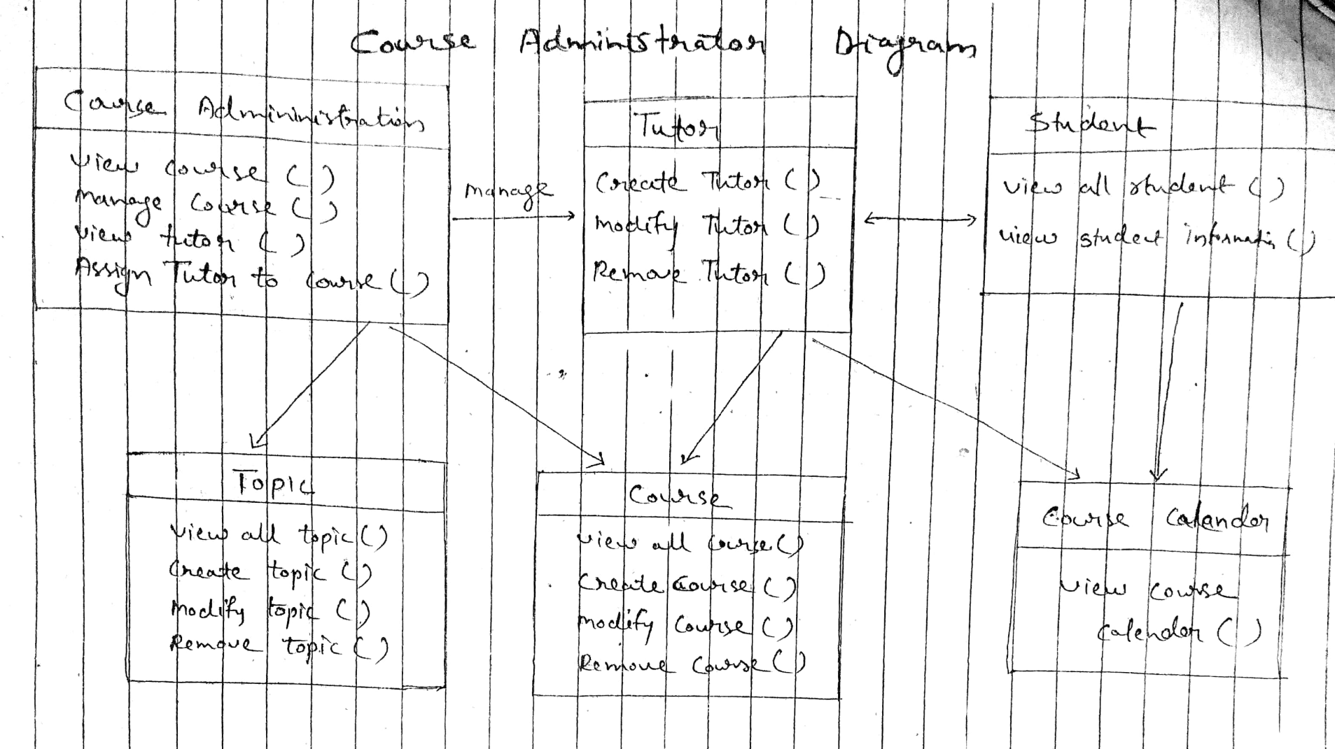

Slide 13
Object Diagram
Object diagrams can be described as an instance of class diagram. Thus, these diagrams are more close to real-life scenarios where we implement a system.
Object diagrams are a set of objects and their relationship is just like class diagrams. They also represent the static view of the system.
The usage of object diagrams is similar to class diagrams but they are used to build prototype of a system from a practical perspective.

Slide 14
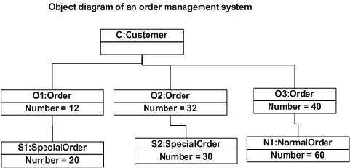

Slide 15
THANK YOU

